Slide 1



WORLD CLASS SERVICES
COST DEPLOYMENT PILLAR
Pillar Board
Junior Ñiquen Neciosup | 09-02-2023

Slide 2
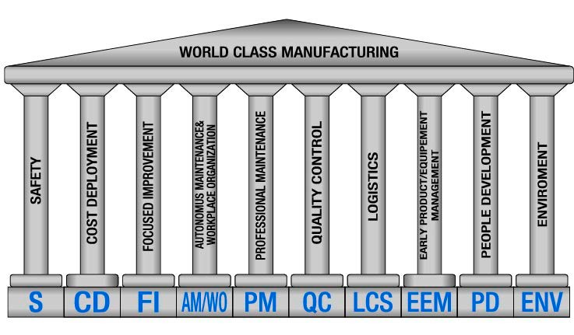
World Class Services Pillars
World Class Manufacturing consists of 10 Managerial Pillars and 10 Technical Pillars.
Notes:
Heavier content slide.

Slide 3
Contents
1. Introduction
1.1 Vision, Needs, Objectives & Target
1.2 KPI & KAI
1.3 Route Map
1.4 Pillar Team & Radar Chart
1.5 Master Plan
1.6 Governance & Meeting System
1.7 Training Schedule
2. Implementation Methodology
2.1 Process Map
2.2 Category Losses
2.3 – 2.8 Step 1-6
2.9 Project review with finance area
2.10 Cost Deployment.
3. Advance 2023
4. SWOT
5. Next Steps
Notes:
Heavier content slide.

Slide 4



1.1 VNOT
VISION
Create a culture of continuous improvement, identifying losses and waste in operations and processes for their elimination.
OBJECTIVES
Stratify losses with data collection from Matrix C
Determine the % of losses from Matrix C and prioritize projects
Prepare projects to reduce losses and follow up with matrices E+F
NEEDS
Commitment and preparation of people to achieve improvements.
Evaluate and validate the CD Matrix losses every year
TARGET
VNOT
KPI | 2022 | 2023
Savings | 0.3 % | 3%
Notes:
Heavier content slide.

Slide 5


1.2 KPI & KAI
Actual Hard Savings YTD [%] (savings can be achieved by eliminating loss and waste).
Target > 0.3% del Perimeter WCS for the 2022 and
Target > 3% for the 2023
Identification of minimum losses by 30% respect to Perimeter WCS
It is required to have the perimeter of the WCS at least 60% of the TTC ( Total Transformation Cost)
Automatization Register >25%
Number of people involved in understanding and applying the WCS methodology and in the waste register
Revision of the Matrices every year, and subsequently maximum semester
Number of projects carried out from E Matrix.
Number of people involved in projects
Notes:
Heavier content slide.

Slide 6
1.3 ROUTE MAP
Year
2022
2023-1
2023-2
2024
2025
Pillar Score
Kick Off
2
3
4
5
Methodology and Main Process
CD KPI
Radar Chart team CD
Management CD
Elaboration Matrix A, B, C, D
Training E+F
Integrated Pillars WCS
Covers more than 80% of the WCS perimeter
Identification of loss and waste with the finance area
Elaboration Matrix E+F
B/C of training
Preparation of the matrices in detail and with identification of the root cause
Automatization register of waste
Covers more than 100% of the WCS Perimeter
Correct use of cost matrices
Correctly follow the annual budget with Matrix G
KPIs
1. Actual Hard Savings YTD [%]
2. Identification of minimum losses
3. It is required to have the perimeter of the WCS /TTC
4. Automatization Register
0.3 %
30%
60%
25%
3 %
30%
60%
50%
3 %
30%
60%
70%
5 %
30%
60%
80%
5 %
30%
60%
90%
Step
1-4
5-6
7
7
7
Notes:
Heavier content slide.

Slide 7


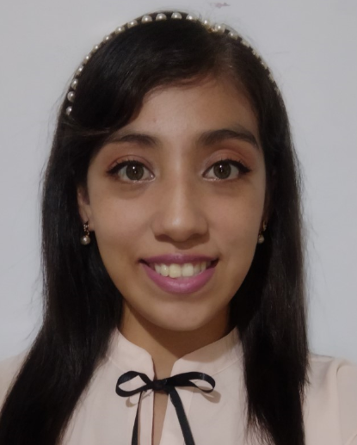


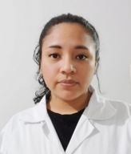


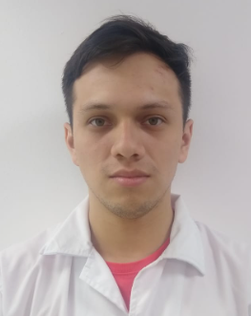
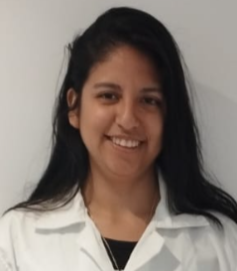

1.4 PILLAR TEAM & RADAR CHART
C
O
R
E
T
E
A
M
Junior Ñiquen N.
Jefe de Laboratorio
CD Pillar Leader
Melisa Medina
Analista LAB EHS
QA Pillar Leader
Leonardo Castillo
Analista LAB EHS
FI Pillar Leader
Maria Braul
Analista LAB EHS
PD Pillar Leader
Yaco Acuña
Analista LAB EHS
EEM Pillar Leader
Extended Team
Olenka Fiestas
Analista LAB EHS
WO Pillar Leader
Ruth Silva
Coor. OI LAB EHS
SAF Pillar Leader
Ana Romero
Analista LAB EHS
LCS Pillar Leader
Juan Vasquez
Analista LAB EHS
AM/PM Pillar Leader
Alessandra Guerrero
Analista LAB EHS
ENV Pillar Leader
Jackelin Pachas
Ingeniero de Procesos y Costos
Group Finances
Notes:
Heavier content slide.

Slide 8
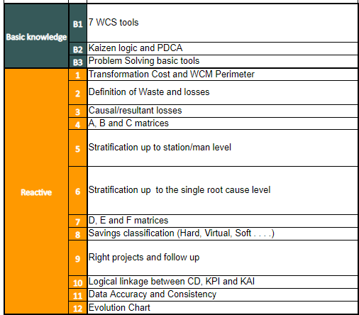
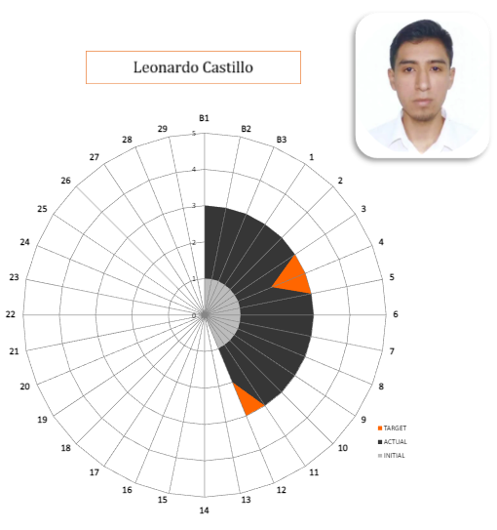
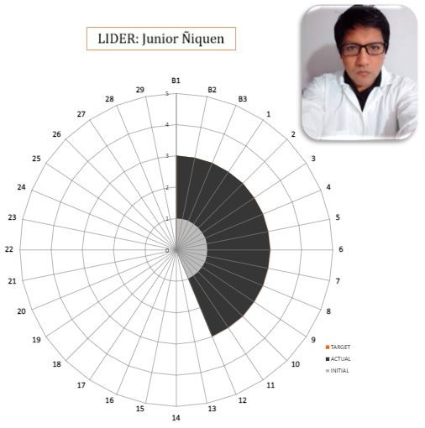
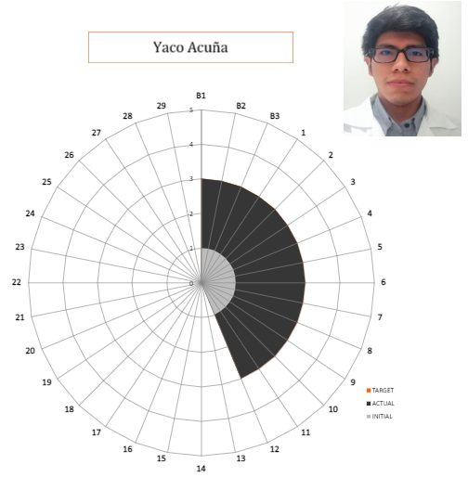
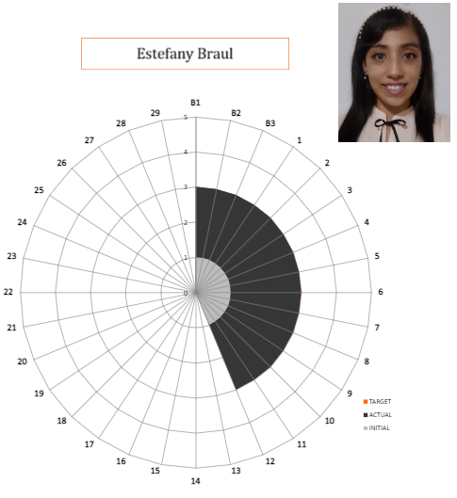
1.4 PILLAR TEAM & RADAR CHART
Notes:
Heavier content slide.

Slide 9
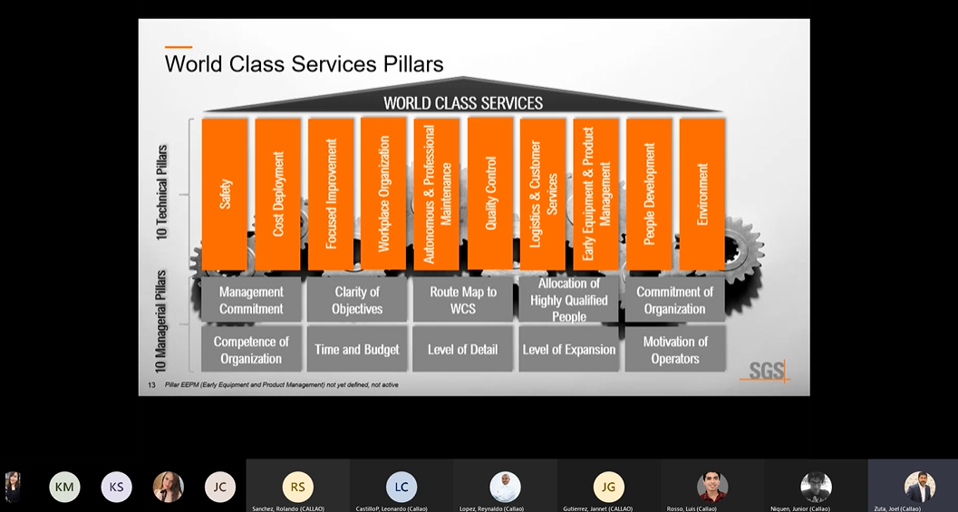
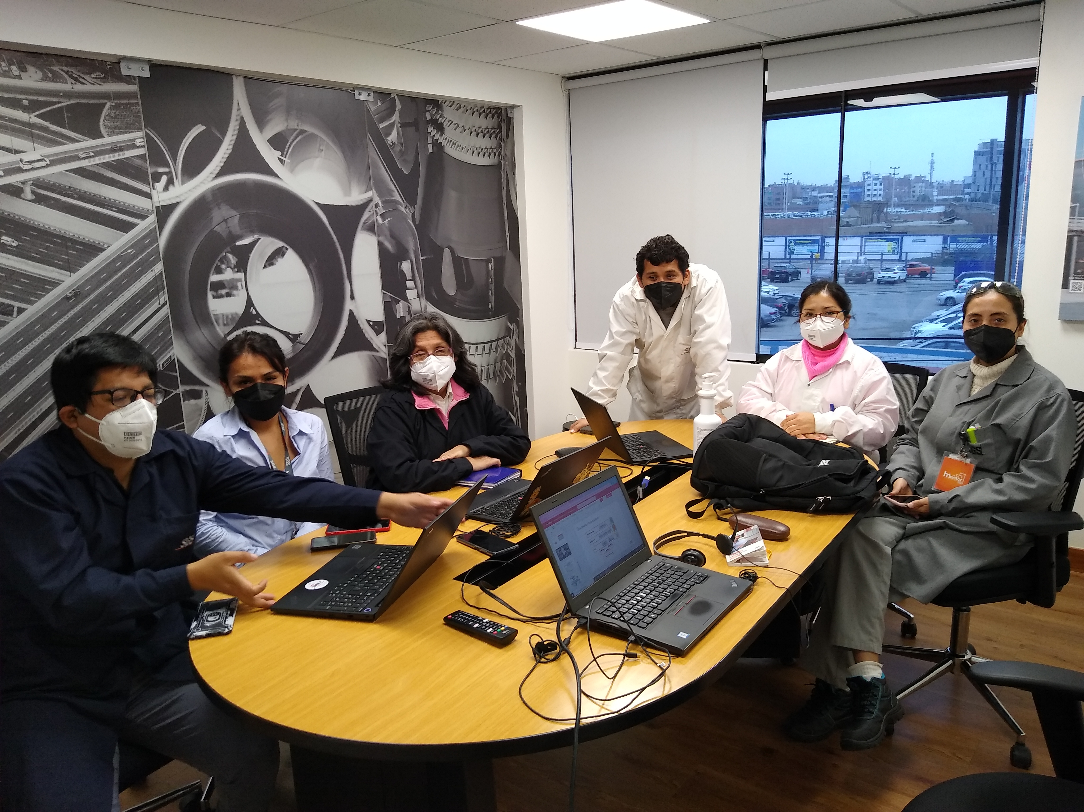
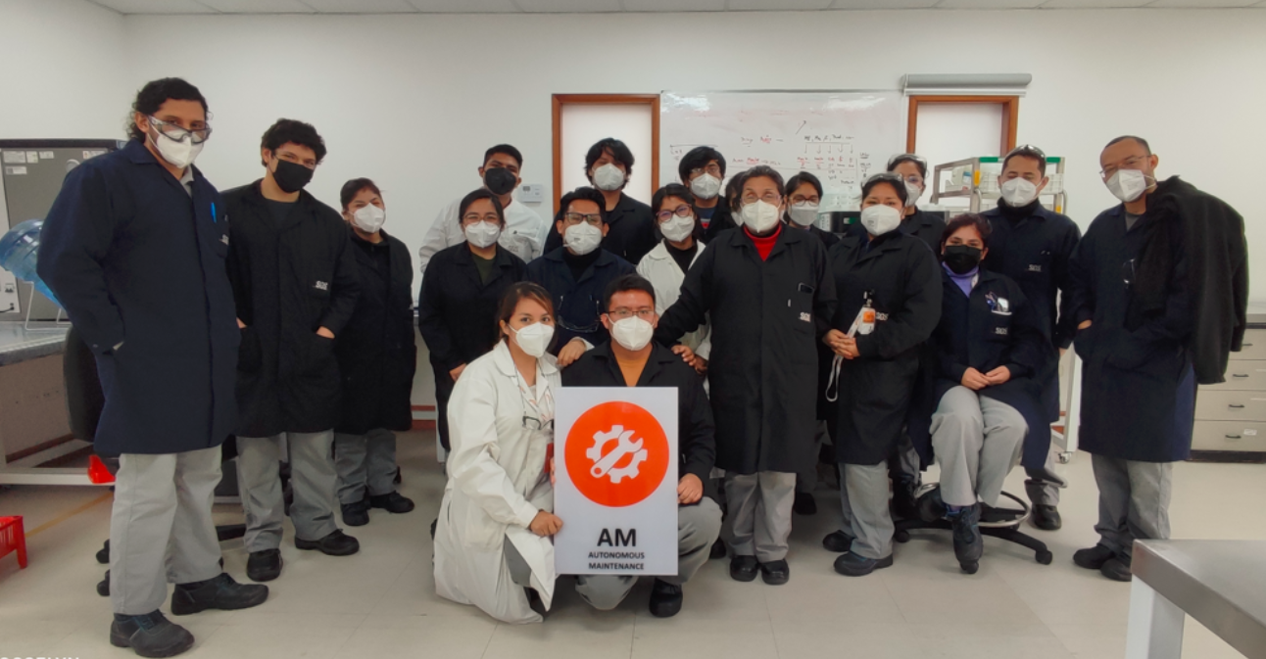
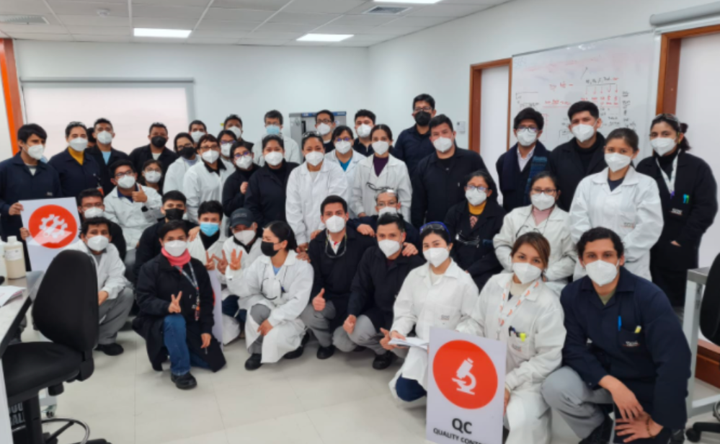
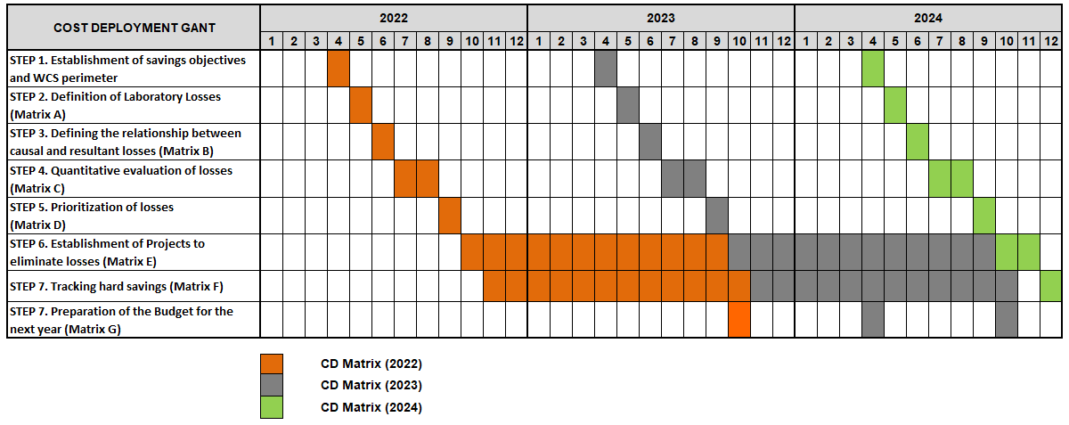
1.5 MASTER PLAN

Slide 10
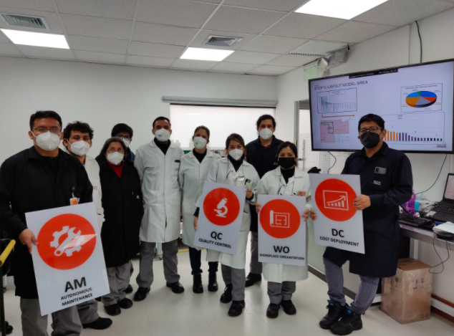
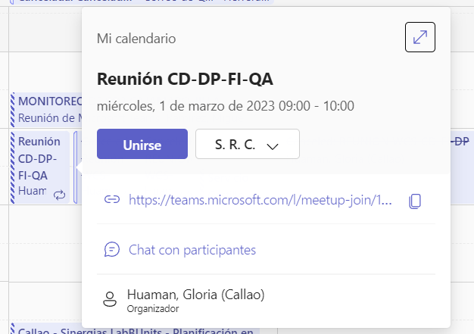
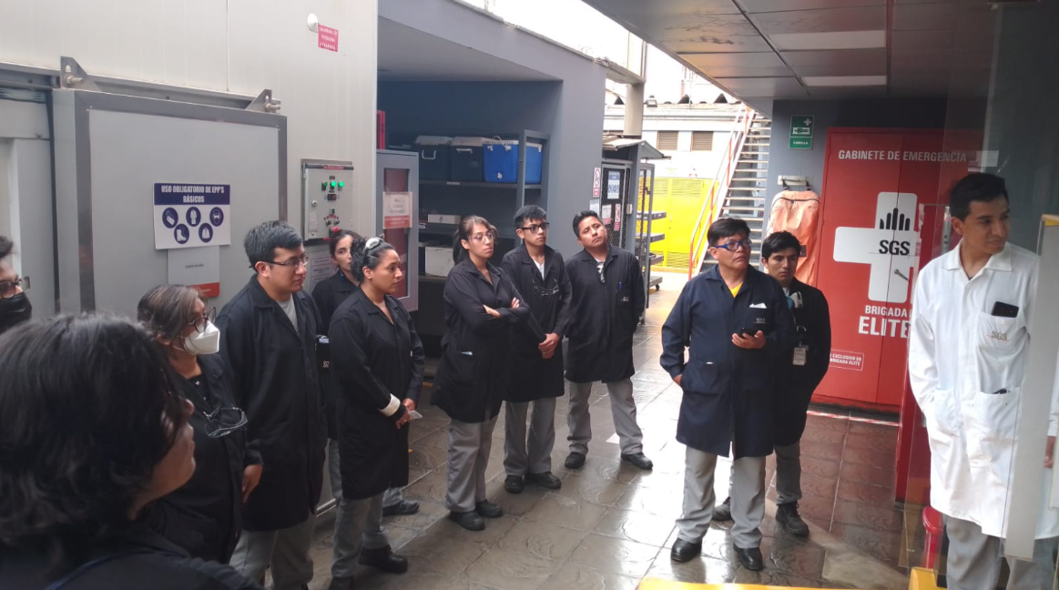
1.6 GOVERNANCE & MEETING SYSTEM
Regarding training, organization, planning and monitoring of activities, the following meetings are held:
Pillar Leaders
Triangle Meeting
Trainings
Monitoring and review of progress of each pillar.​
Dissemination of information.
3. Weekly on Fridays.
Projects review
Dissemination of information.
3. Weekly on Wednesday.
Use of methodologies and tools.
On Tuesday and/or Friday.​

Slide 11
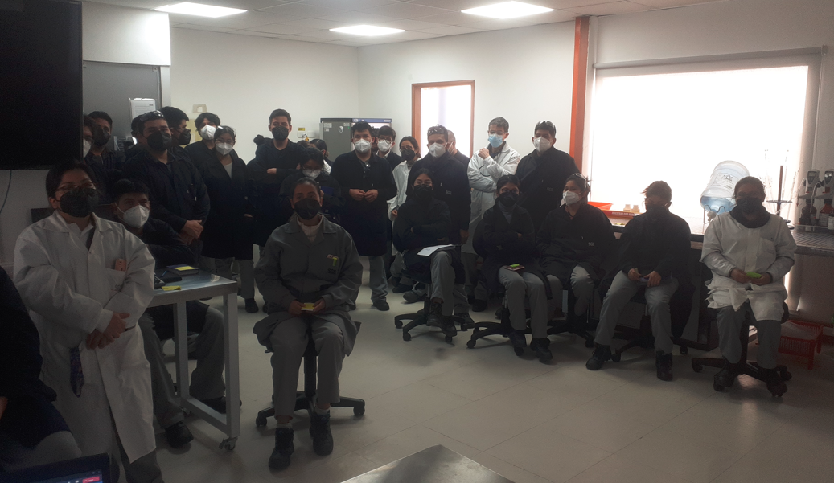
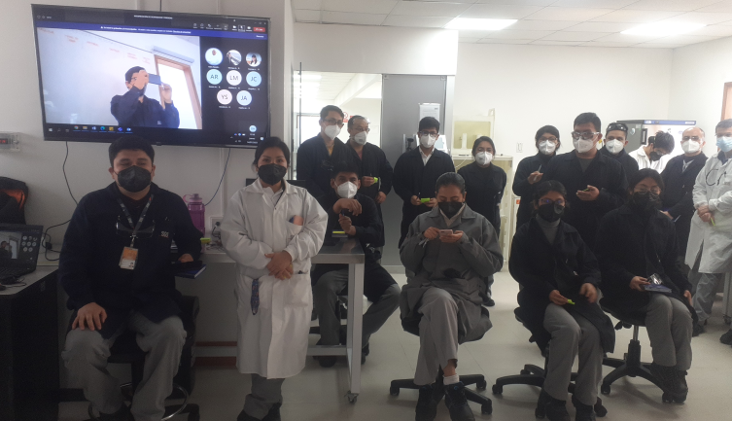
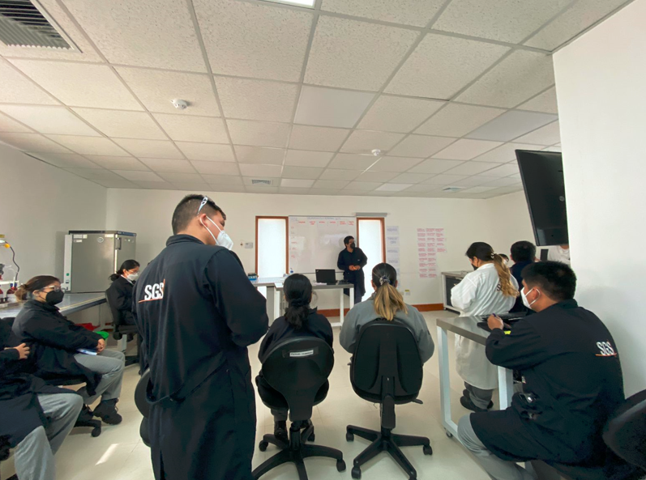
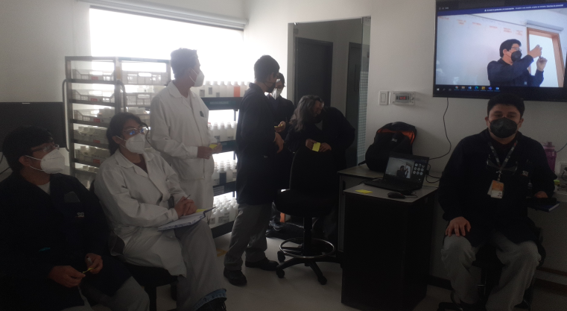
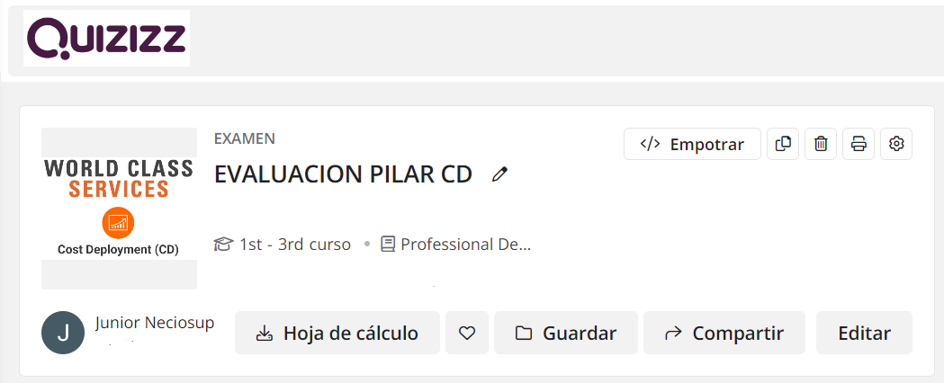
1.7 TRAINING SCHEDULE
DIFUSIÓN OF PILAR CD - TEST IN/OUT
Notes:
Heavier content slide.

Slide 12
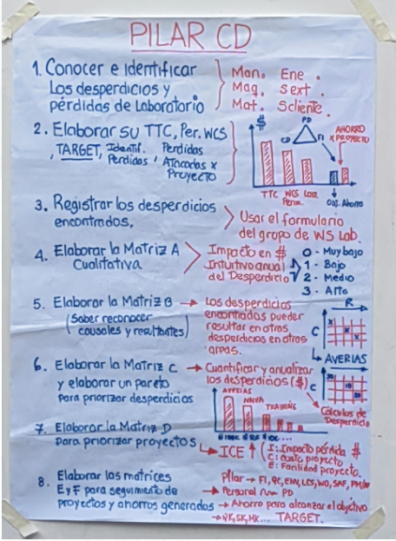
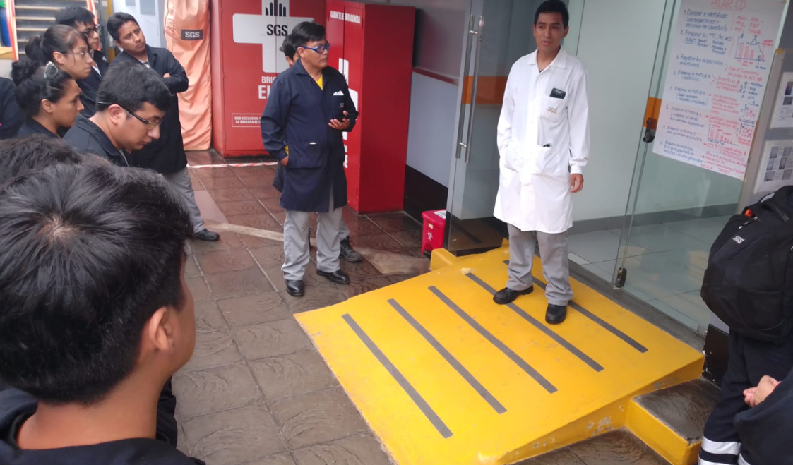
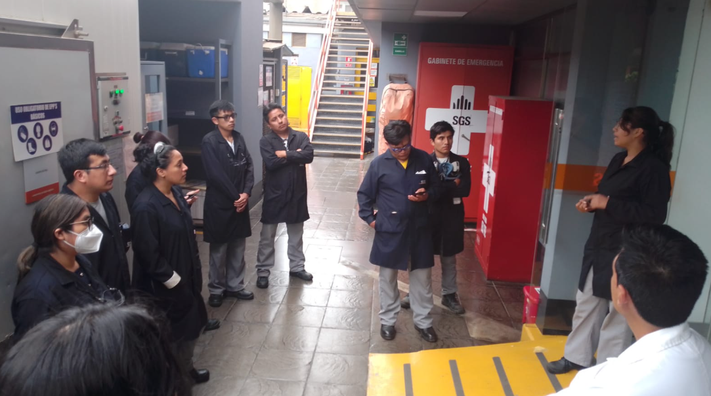
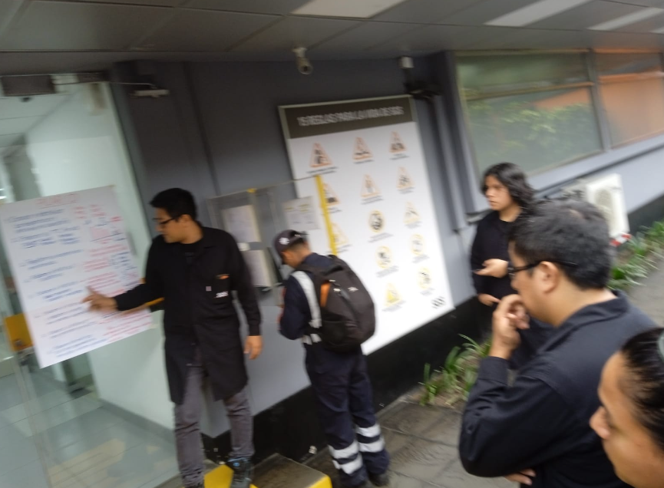
1.7 TRAINING SCHEDULE
DIFUSIÓN OF PILAR CD
Notes:
Heavier content slide.

Slide 13
2. IMPLEMENTATION METHODOLOGY
INFORMATION COLLECTION MATRICES
EXECUTION MATRICES
MATRIX TO PRIORITIZE LOSS ELIMINATION
Notes:
Heavier content slide.

Slide 14
2.1 PROCESS MAP (2021-2022 – Abril)
Departament | Station | FTE | Machines
Data Center | Recepción de Muestras | 9 | 6
Data Center | DATA Center / DATA Center | 2 | 3
Metales | Sala de Digestión | 6 | 11
Metales | Sala Instrumental III | 4 | 6
Metales | Evaluación de Resultados | 4 | 4
Instrumental 2 | Sala Instrumental 2 | 4 | 7
Instrumental 1 | Sala Colorimetrica | 6 | 4
Instrumental 1 | Sala Instrumental | 5 | 6
Aires | Preparativa Aires | 1 | 1
Aires | Sala de Filtros | 5 | 4
Departament | Station | FTE | Machines
GCMS | Extracción de GCMS, HPLCMSMSy AyG | 4 | 5
GCMS | Lectura de GCMS | 5 | 10
GCMS | Lectura de HPLCMSMS | 1 | 2
GCMS | Lectura de DRX | 0 | 2
Lavado | Sala de Lavado | 2 | 6
Suelos | Sala de Suelos | 2 | 11
Segundo Piso | Sala de Balanzas | 0 | 2
Segundo Piso | Sala de Fisicoquimicos | 6 | 17
Segundo Piso | Sala de DBO | 2 | 7
Segundo Piso | Sala de Lavado 2 | 1 | 2
Stratification of Laboratory Workstations
N° Departament: 9
N° Station: 20
N° FTE: 69
N° Equipment: 116
Notes:
Se movió a mapa de procesos y se elimina del pas dos.

Slide 15
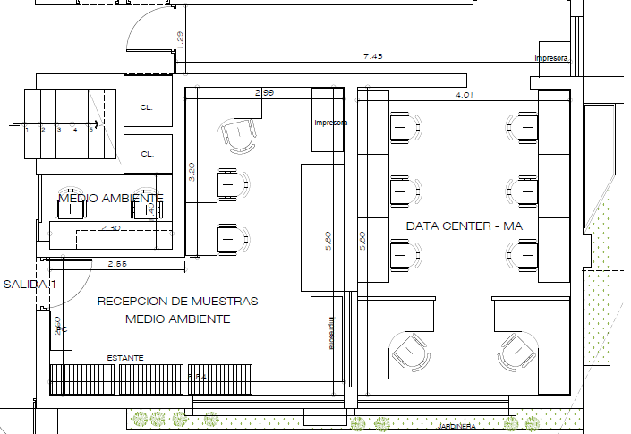
2.1 PROCESS MAP (2021-2022 – Abril)
Ubic. | Área | FTE | Machines
1 | Recepción de Muestras | 9 | 6
2 | DATA Center / DATA Center | 2 | 3
3 | Lectura de DRX | 0 | 2
3
1
2
Notes:
Heavier content slide.

Slide 16
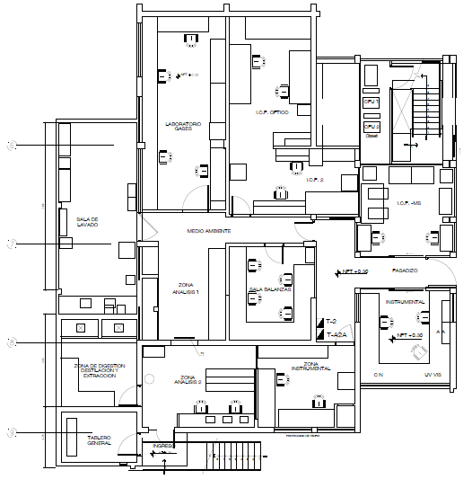
2.1 PROCESS MAP
Ubic. | Area | FTE | Machines
4 | Sala Instrumental III | 4 | 6
5 | Sala Instrumental II | 4 | 7
6 | Sala Instrumental I | 5 | 6
7 | Sala de Filtros | 5 | 4
8 | Extracción de GCMS, HPLCMSMS y AyG | 4 | 5
9 | Lectura de GCMS | 5 | 10
10 | Sala de Lavado | 2 | 6
11 | Preparativa Aires | 1 | 1
12 | Sala Colorimétrica | 6 | 4
13 | Sala de Digestión | 6 | 11
14 | Evaluación Resultados | 4 | 4
9
8
10
4
11
7
5
13
6
12
On the First Floor Laboratory we have 10 zones. Zone 14 is currently HOME OFFICE.
14
Notes:
Heavier content slide.

Slide 17
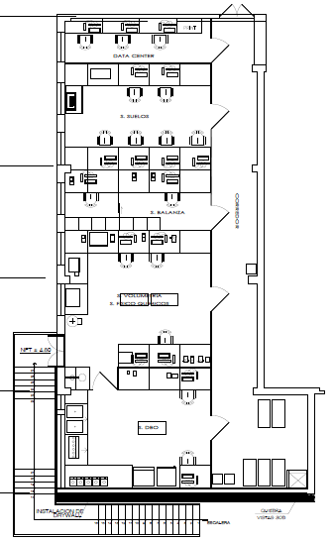
2.1 PROCESS MAP
15
16
UBIC. | AREA | FTE | Machines
15 | Lectura de HPLCMSMS | 1 | 2
16 | Sala de Suelos | 2 | 11
17 | Sala de Balanzas | 0 | 2
18 | Sala de Fisicoquímicos | 6 | 17
19 | Sala de DBO | 2 | 7
20 | Sala de Lavado 2 | 1 | 2
17
18
20
19
Notes:
Heavier content slide.

Slide 18
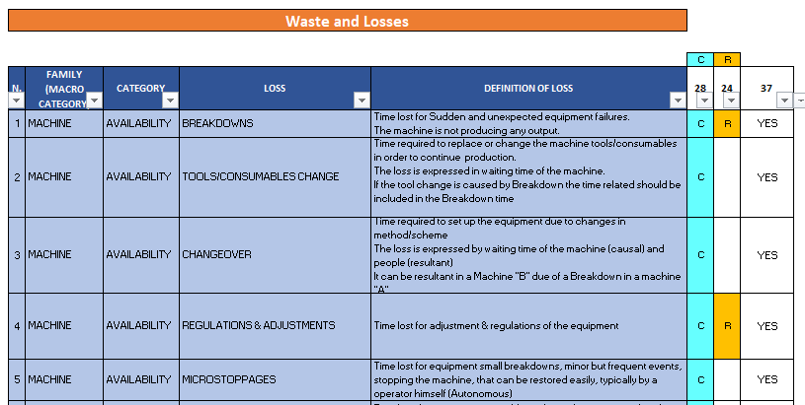
2.2 CATEGORY LOSSES
1
4
5
2
3
6
7
Familia​ | Causal ​ | Resultante​ | C / R | Total ​
MACHINE​ | 12 | 6 | 3 | 15
MANPOWER​ | 6 | 7 | 4 | 9
MATERIAL​ | 4 | 5 | 4 | 5
ENERGY/ENV​ | 2 | 2 | 1 | 3
OUTS. / EXT​ | 2 | 2 | 1 | 3
CUSTOMER SERVICES​ | 2 | 2 | 2 | 2
TOTAL | 28 | 24 | 15 | 37
Tipo | N°
C | 13
C/R | 15
C | 9
The definitions of Waste were reviewed, to establish according to the EHS Laboratory processes, finding Causal and Resulting losses that are summarized in the table on the right side.
Notes:
Heavier content slide.

Slide 19
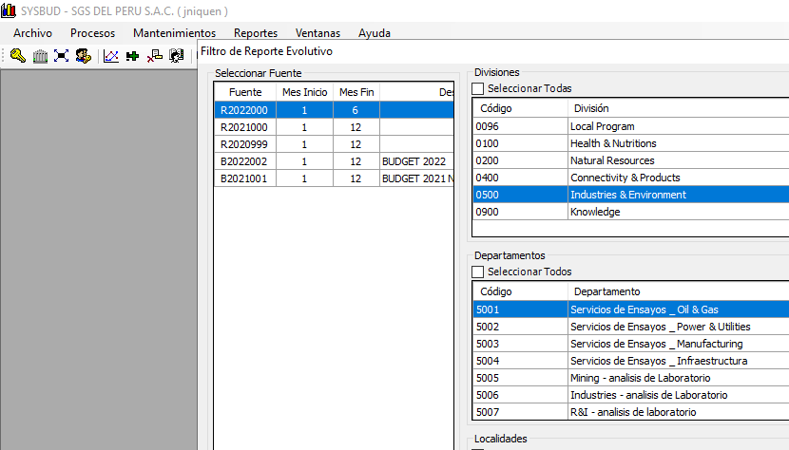
1
4
5
2
3
6
7
2.3 COST DEPLOYMET STEP 1
Cod cta. | Line | TTC | WCS Perimeter
5001110 | Personal | -505275 | -505275
5505619 | Material tecnico (Otros) | -411644 | -411644
5300421 | Dep.Maquinaria y Equipo- Laboratorio | -388652
92101 | Distribución Personal - Back Office | -207298 | -207298
5505601 | Material tecnico (vidrios y plasticos) | -202120 | -202120
5507612 | HERRAMIENTAS Y REPUESTOS | -169415 | -169415
5505602 | Material tecnico (reactivos) | -142816 | -142816
5001141 | Gratificación empleados | -89141
5505603 | Material tecnico (gases) | -81425 | -81425
5503521 | Alquiler de inmuebles | -77792
5507361 | Mant. Maq, y equipo de lab. Y oper. | -60498 | -60498
5300141 | DEP.EDIFICACIONES-MEJORAS INMU | -52279
5009911 | CTS - Empleados | -52000
5005751 | SEGURO MEDICO FAMILIAR - RIMAC | -46701
99101 | Distribución Other expenses - Back Office | -45592 | -45592
5005710 | APORTACIONES ESSALUD | -40125
5200111 | Transportes de carga | -39432 | -39432
5505615 | EPP y Ropa de Servicio | -39208 | -39208
5001151 | Vacaciones empleados | -38466
5507311 | Mant. De inmuebles alquilados | -32777
Data Collection
Main Sources: SysBud SGS Perú
This is the starting point: The Stratification of the Total Transformation Cost
Projection of the year 2021 for 2022 by 10% due to increase in sales.
Notes:
Llevar el Perimetro el WCS al 80% del TTC
¿Es correcto hacerlo con un 10% de incremento de ventas?
Revisar las lineas de la cuenta 50 donde sson perdodas por Casitgos por UMBIL. Es una perdida que no debería considerarse en el proyectado. Debe quedarse fuera desde el TTC si bien quedo fuera desde el perimetro.
Agregar la linea de otros gastos en otro SLIDE

Slide 20
1
4
5
2
3
6
7
2.3 COST DEPLOYMET STEP 1
Cod cta. | Line | TTC | WCS Perimeter
92100 | Distribución Personal - Indirectos | -31986 | -31986
5200123 | Transporte colectivo de personal | -31030
5300451 | Dep. Equipos diversos | -30120
5549416 | Castigo Unbilled Revenue | -28538
5548610 | Energía Eléctrica | -24493 | -24493
5100992 | Examenes medicos al personal | -24382 | -24382
5507613 | Herramientas y Repuestos - Provisión | -23981 | -23981
5003211 | BONO POR RESULTADO | -21856
5200119 | Movilidad local - vales | -21692 | -21692
5200122 | Movilidad local-Comprobantes | -20799 | -20799
5100922 | Ensayos análisis,otros- terceros | -19494 | -19494
5300452 | Dep. Hardware | -18612
5300213 | Amort. Programas de computadoras (software) | -18603
5300422 | Dep.Maquinaria y Equipo- Operaciones | -18334
5505640 | Activo fijo menor | -17335 | -17335
5523522 | ALQUILER INMUEB- LABORAT CALLA | -16690 | -16690
5003111 | Participación de los trabajadores - corriente | -15840
5504122 | Correos nacional | -15027 | -15027
5507812 | Servicio contratado de vigilancia y seguridad | -14824
5507363 | Mantenimiento Maquinas, Equipo - Provisión | -13532 | -13532
Cod cta. | Line | TTC | WCS Perimeter
5005752 | Aportaciones EPS | -10973
5507362 | Calibración de equipos | -9646 | -9646
5507811 | Servicio contratado de limpieza | -9526
5507331 | Mant.Muebles y Enseres | -8782
5507611 | UTILES DE ASEO | -7511 | -7511
5511655 | Licencias de software | -7494
5001161 | Asignación familiar-Empleados | -7365
95100 | Distribución Travel - Indirectos | -7029
5504121 | Correos internacional | -6753 | -6753
5507342 | Mant. Aire Acondicionado | -6598 | -6598
98100 | Distribución Depreciación - Indirectos | -6470
5548631 | Agua | -6292 | -6292
5003221 | Bonif. extraordinaria empleado | -6199
5511610 | Materiales para Computadora | -6065
5511532 | Alquiler de Impresoras | -5920
98101 | Distribución Depreciación - Back Office | -5193
93100 | Distribución Other Group - Indirectos | -4767 | -4767
5002231 | Sobretiempo empleados | -4736 | -4736
5001131 | AGUINALDO EMPLEADOS | -4502
5506608 | UTILES DE ESCRITORIO | -4491 | -4491
Notes:
Llevar el Perimetro el WCS al 80% del TTC
¿Es correcto hacerlo con un 10% de incremento de ventas?
Revisar las lineas de la cuenta 50 donde sson perdodas por Casitgos por UMBIL. Es una perdida que no debería considerarse en el proyectado. Debe quedarse fuera desde el TTC si bien quedo fuera desde el perimetro.
Agregar la linea de otros gastos en otro SLIDE

Slide 21
1
4
5
2
3
6
7
2.3 COST DEPLOYMET STEP 1
Cod cta. | Line | TTC | WCS Perimeter
93120 | Distribución Subcontracted 3rd - Indirecto | -4474 | -4474
5100815 | Eliminacion y tratamiento de desechos | -4374 | -4374
95101 | Distribución Travel - Back Office | -4236
5511441 | Mant.Software - terceros | -4223
5511353 | Mant. Red Local | -4198
5110921 | Ensayos análisis - subsidirias | -3645
5504642 | Celular | -3410
5300144 | Dep. Muebles y Enseres | -3176
5511351 | Mant. Hardware | -3104
5507619 | Materiales eléctricos - Mantenimiento | -2452 | -2452
5100816 | Servicios de limpieza Industrial | -2416 | -2416
93121 | Distribución Subcontracted 3rd - Back Office | -2324 | -2324
5100291 | Honorarios - consultoría | -2164
5005731 | Seguro complementario de trabajo de riesgo | -2103
5004514 | Gastos de cafetería | -2049
5200994 | Gastos de Flete de importación | -1817
5004511 | Agasajos al personal | -1775
5506607 | FORMATOS | -1213 | -1213
5511609 | Materiales de Copiadora | -1180
5507618 | gastos de ferreteria | -1096 | -1096
Cod cta. | Line | TTC | WCS Perimeter
5005741 | SEGURO DE VIDA LEY 4916 | -992
5504123 | Mensajería | -644
5003223 | Bonos por Internet | -597
5004244 | Incentivos al Personal | -264
5100999 | Otros servicios diversos | -143
5200161 | Gastos de viaje local - Movilidad Pasajes Aéreos | -133
5004252 | Alimentación principal | -57
5200120 | SEGURO DE VEHICULOS | -51
5200141 | Gastos de alimentación - local | -44 | -44
5014410 | Capacitación al personal | -36 | -36
5200153 | Gastos de viaje local - otros | -28
5014513 | Botiquin | -22
5014962 | Otros servicios - relacionados al personal | -13
5200131 | Gastos de alojamiento local | 0
5504641 | Teléfono | 0
5200151 | Gastos de pasaje y movilidad - local | 19
5100971 | SERVICIO DE CUSTODIA DE DOCUMENTOS | 29
5504993 | WAN NACIONAL | 125
93101 | Distribución Other Group - Back Office | 341
5015951 | Personal eventual | 697
5016111 | Subvención del gobierno para gastos de personal | 1001
Notes:
Llevar el Perimetro el WCS al 80% del TTC
¿Es correcto hacerlo con un 10% de incremento de ventas?
Revisar las lineas de la cuenta 50 donde sson perdodas por Casitgos por UMBIL. Es una perdida que no debería considerarse en el proyectado. Debe quedarse fuera desde el TTC si bien quedo fuera desde el perimetro.
Agregar la linea de otros gastos en otro SLIDE

Slide 22
1
4
5
2
3
6
7
2.3 COST DEPLOYMET STEP 1
Accounts that were not part of the TTC
Cod cta. | Line
5522443 | Mant.Software - grupo
5522997 | WAN INTERNACIONAL/GRUPO
5523991 | OTROS SERVICIOS INTERDIVISIONA
5110931 | Otros servicios subsidiarias
93140 | Distribución Subcontracted Group - Indirecto
5501411 | Cuentas por cobrar comerciales -terceros
5505561 | Alquiler de equipos diversos
5508711 | Publicidad divisional
5508712 | Publicidad institucional
5510222 | Consultores/Asesores
5513911 | Gastos bancarios
5514131 | IGV no recuperado
5514321 | Arbitrios municipales y seg. Ciudadana
5516300 | SUSCRIP. REVISTAS Y PUBLICACIO
5516302 | COTIZACIONES
Cod cta. | Line
5516411 | LICENCIAS Y DERECHOS DE VIGENC
5516442 | Provisión MTTO, Software - IT
5516652 | Provisión Exchange - IT
5516653 | Provisión Wan International - IT
5516921 | Sanciones Administrativas fiscales-multas
5516922 | SANC. ADMIN. FISCALES-INTERESE
5516991 | Otros Ingresos de gestión diversos
5516999 | Otros gastos de gestion
99100 | Distribución Other expenses - Indirectos
5517600 | PERDIDA POR DIFERENCIA DE CAMB
5517760 | DIFERENCIA DE CAMBIO
5519392 | Retenciones del Exterior no Recuperable
5545111 | Descuentos concedidos
5547130 | Seguro de robo y asalto
5547140 | Seguro responsabilidad civil
Notes:
Llevar el Perimetro el WCS al 80% del TTC
¿Es correcto hacerlo con un 10% de incremento de ventas?
Revisar las lineas de la cuenta 50 donde sson perdodas por Casitgos por UMBIL. Es una perdida que no debería considerarse en el proyectado. Debe quedarse fuera desde el TTC si bien quedo fuera desde el perimetro.
Agregar la linea de otros gastos en otro SLIDE

Slide 23
1
4
5
2
3
6
7
2.3 COST DEPLOYMET STEP 1
TTC | WCS Perimeter
$ -3,342,375 | $ -2,203,356
COST PERIMETER
USD 2,203 K
Estimated from 2021 (In the month of March 2021)
We will focus on these losses
(66%)
Notes:
Heavier content slide.

Slide 24
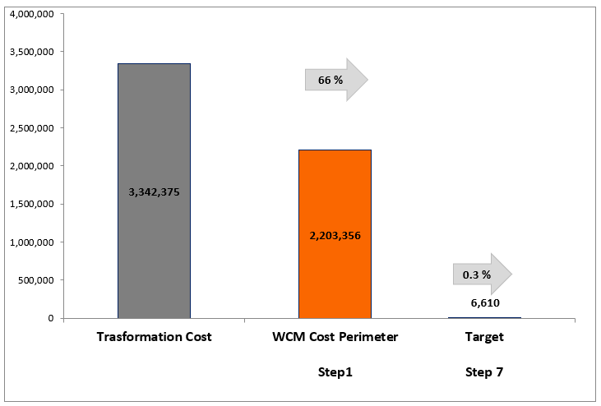
2.3 COST DEPLOYMET STEP 1
1
4
5
2
3
6
7
Cod cta. | Line | WCS Perimeter
5001110 | Personal | -505275
5505619 | Material tecnico (Otros) | -411644
92101 | Distribución Personal - Back Office | -207298
5505601 | Material tecnico (vidrios y plasticos) | -202120
5507612 | HERRAMIENTAS Y REPUESTOS | -169415
5505602 | Material tecnico (reactivos) | -142816
5505603 | Material tecnico (gases) | -81425
5507361 | Mant. Maq, y equipo de lab. Y oper. | -60498
99101 | Distribución Other expenses - Back Office | -45592
5200111 | Transportes de carga | -39432
5505615 | EPP y Ropa de Servicio | -39208
92100 | Distribución Personal - Indirectos | -31986
CHART EVOLUTION COST
(USD)
Notes:
Se cambia el gráfico del Loss Identifed por Target

Slide 25
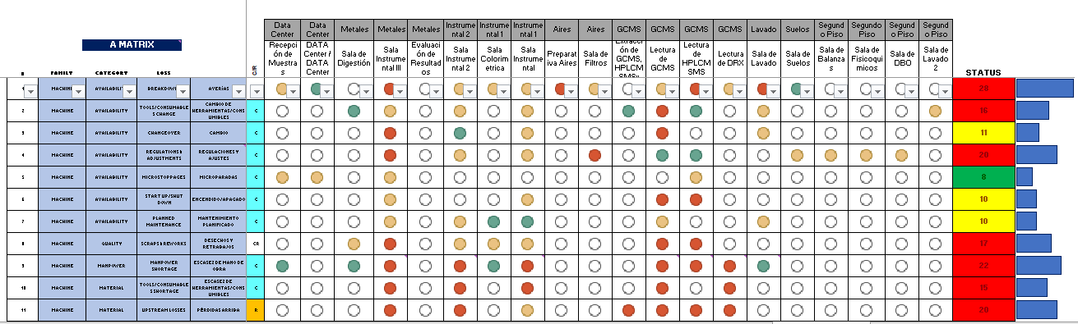
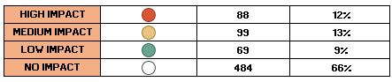
2.4 COST DEPLOYMET STEP 2
1
4
5
2
3
6
7
A MATRIX
Identification of loss and waste quality
20 Sub-Processes
Identified
37 Type of Losses Identified
Shows the link between Losses identified and Workstations
Notes:
Heavier content slide.

Slide 26
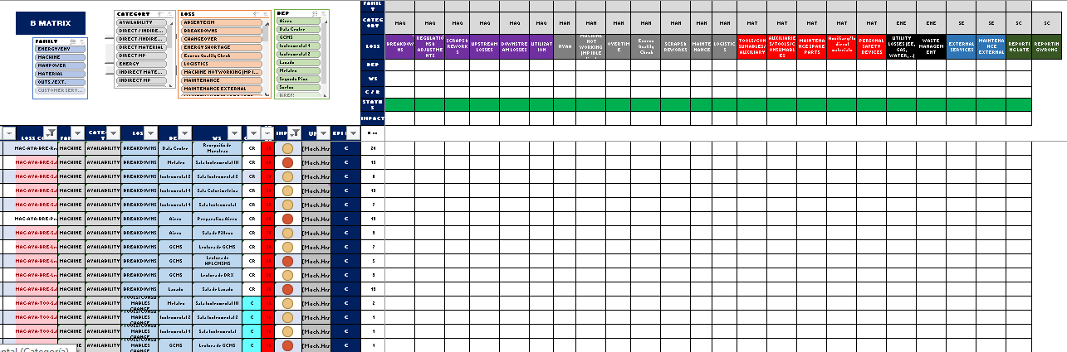
2.5 COST DEPLOYMET STEP 3
1
4
5
2
3
6
7
RESULTANT LOSSES
B MATRIX
Separation of causal from resulting losses
CAUSAL LOSSES
It defines the impact of each causal loss on the process and generates a resultant losses in each work substation. This will allow to identify real sources of losses
Notes:
Heavier content slide.

Slide 27
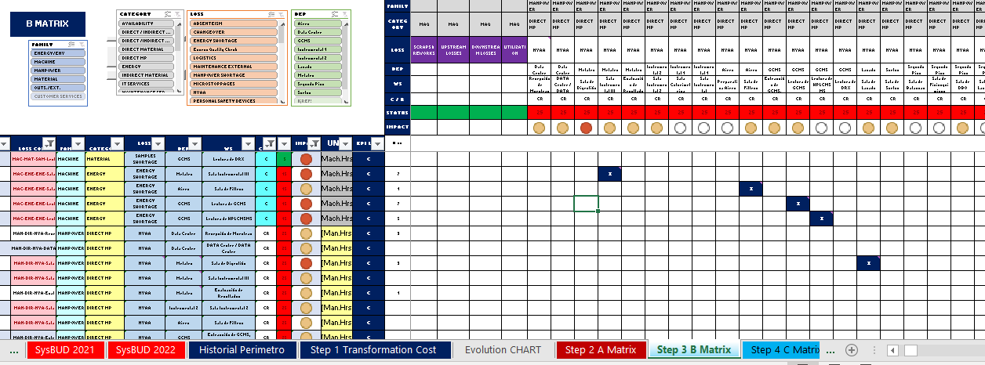
2.5 COST DEPLOYMET STEP 3
1
4
5
2
3
6
7
RESULTANT LOSSES
B MATRIX
Separation of causal from resulting losses
CAUSAL LOSSES
It defines the impact of each causal loss on the process and generates a resultant losses in each work substation. This will allow to identify real sources of losses
Notes:
Heavier content slide.

Slide 28
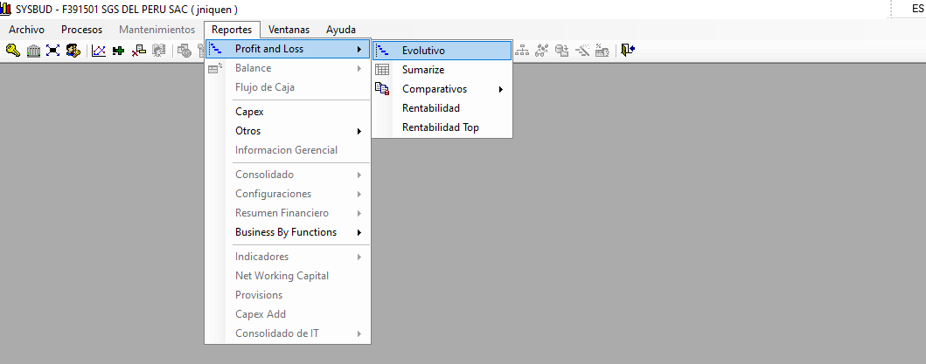
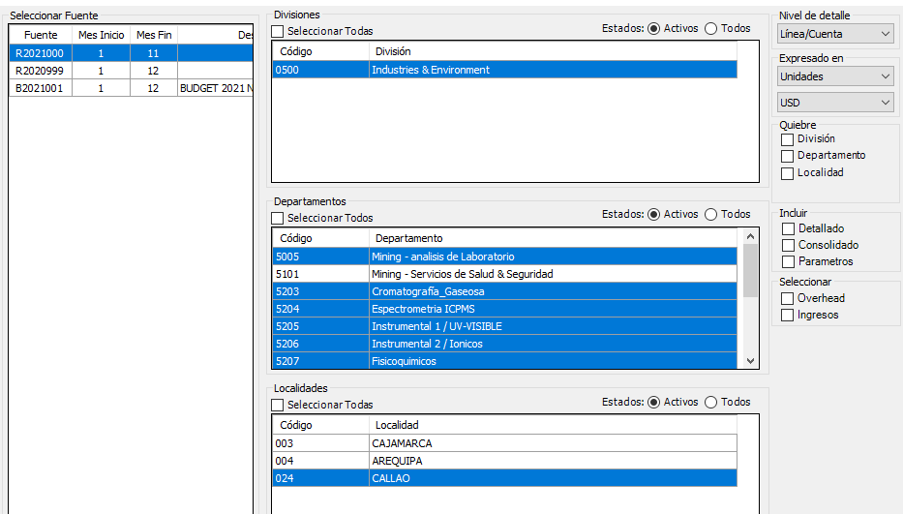
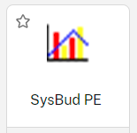
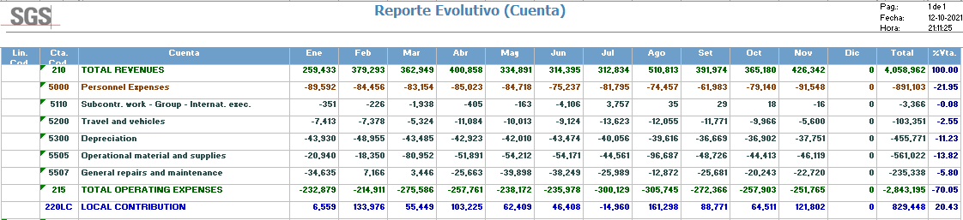
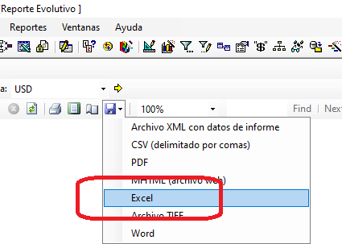
2.5 COST DEPLOYMET STEP 3
1
4
5
2
3
6
7
DATA COLLECTION
To obtain get the general expenses, information was obtained from the SYSBUD Software, selecting our Cost Centers and using the Excel report.
Notes:
Heavier content slide.

Slide 29
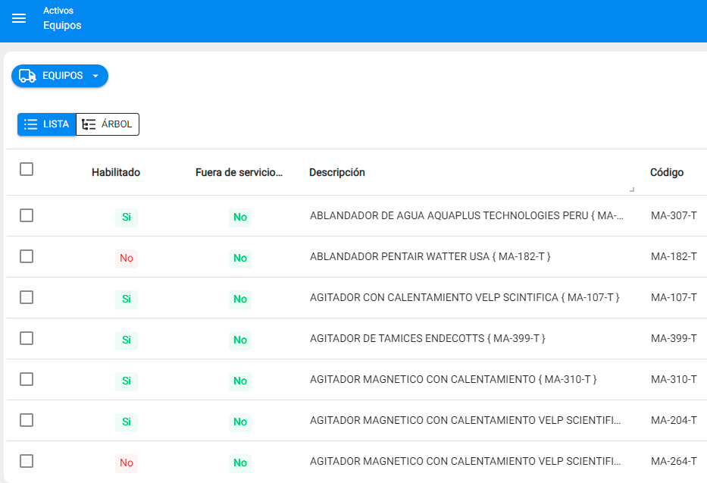

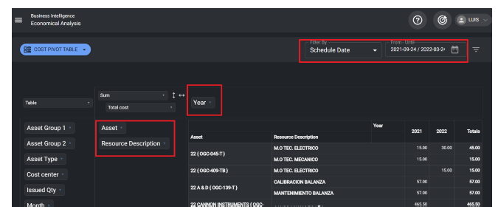
1
4
5
2
3
6
7
2.5 COST DEPLOYMET STEP 3
DATA COLLECTION
To obtain Machine Losses we use the Fractal One Software to obtain the information.
Notes:
Heavier content slide.

Slide 30
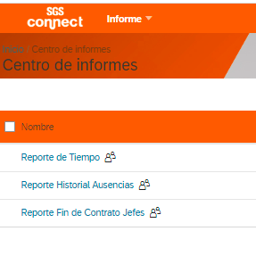

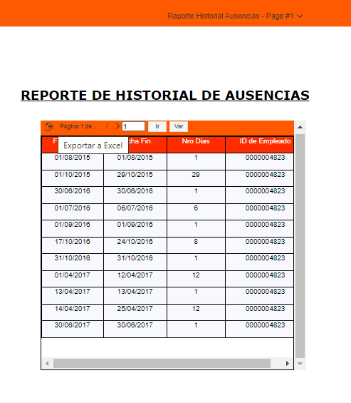
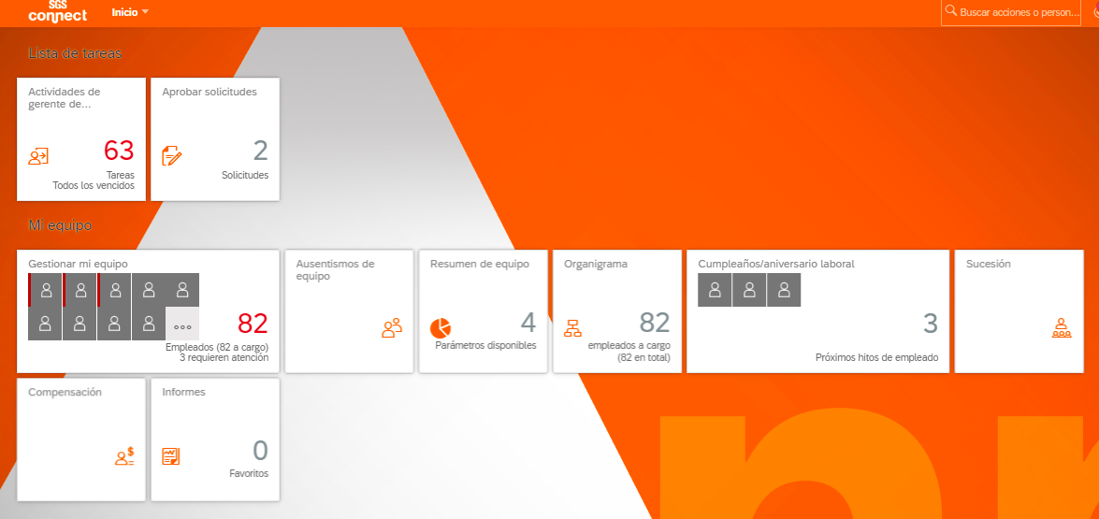
1
4
5
2
3
6
7
2.5 COST DEPLOYMET STEP 3
DATA COLLECTION
To obtain Manpower Losses (absences,vacations), we use the SGS Connect Software to obtain the information.
Notes:
Heavier content slide.

Slide 31

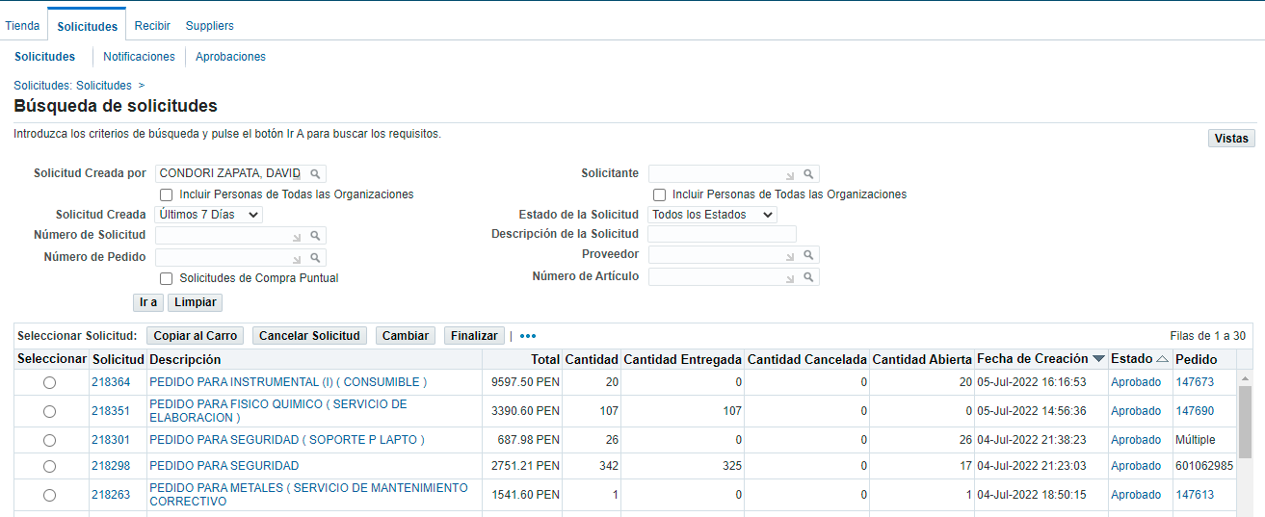
1
4
5
2
3
6
7
2.5 COST DEPLOYMET STEP 3
DATA COLLECTION
To obtain the Material Losses we use the BOSS Software (ORACLE iProcurement) to obtain the information.
Notes:
Heavier content slide.

Slide 32
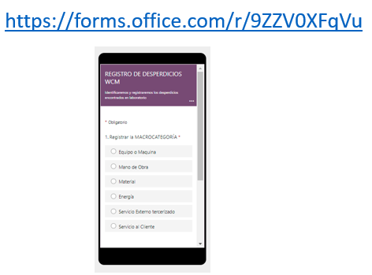
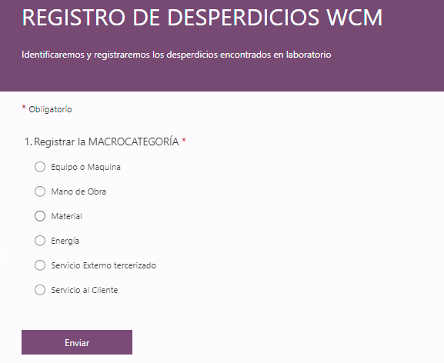


1
4
5
2
3
6
7
2.5 COST DEPLOYMET STEP 3
DATA COLLECTION
To obtain the Total Losses, we use “Microsoft Forms”, which is filled out by the laboratory staff, to obtain the information for the matrices.
Notes:
Heavier content slide.

Slide 33



1
4
5
2
3
6
7
2.5 COST DEPLOYMET STEP 3
DATA COLLECTION
To obtain the Losses, we use “Microsoft Forms” to obtain the information for the matrices and visualize it in a PowerBI
Notes:
Elaborar una matriz de responsabilidades.
Quienes son los que registran o toman la data
Quieenes son los que revisan la data
Quien es el que valida la data.

Slide 34

2.6 COST DEPLOYMET STEP 4
1
4
5
2
3
6
7
c MATRIX
Calculation of loss and waste costs
It is made from the causal losses of matrix B. Linked to losses and waste.
Notes:
Heavier content slide.

Slide 35

2.6 COST DEPLOYMET STEP 4
1
4
5
2
3
6
7
c MATRIX
Calculation of loss and waste costs
Losses are usually measured in physical units (Hr/machine, Hr/man, KWh, etc) then these are quantified (USD)
Notes:
Heavier content slide.

Slide 36


2.6 COST DEPLOYMET STEP 4
1
4
5
2
3
6
7
c MATRIX
Calculation of loss and waste costs
Losses are usually measured in physical units (Hr/machine, Hr/man, KWh, etc) then these are quantified (USD)
Notes:
Heavier content slide.

Slide 37

2.6 COST DEPLOYMET STEP 4
1
4
5
2
3
6
7
CHART EVOLUTION COST
(USD)
Notes:
Se cambia el gráfico del Loss Identifed por Target

Slide 38

2.6 PARETO CHART STEP 4
1
4
5
2
3
6
7
LOSS | USD
BREAKDOWN | 318,415
TRAINING | 137,940
NVAA | 132,234
REGULATIONS & ADJUSTMENTS | 39,136
CHANGEOVER | 37,326
LOGISTICS | 35,602
SCRAPS & REWORKS | 34,120
ENERGY SHORTAGE | 27,029
MAINTENANCE EXTERNAL | 27,000
TOOLS/CONSUMABLES SHORTAGE | 24,813
ABSENTEISM | 23,681
TOOLS/CONSUMABLES CHANGE | 10,812
Total Losses
USD 893,047
Notes:
Heavier content slide.

Slide 39

2.6 PARETO CHART STEP 4
1
4
5
2
3
6
7
BREAKDOWNS
LOSS | USD
Lectura de GCMS | 146,604
Sala Instrumental III | 123,337
Sala Instrumental 2 | 18,255
Sala de Lavado | 12,574
Sala Instrumental | 9,726
Preparativa Aires | 2,682
Extracción de GCMS, HPLCMSMSy AyG | 1,406
Sala Colorimetrica | 1,199
Lectura de HPLCMSMS | 804
Sala de Filtros | 766
Recepción de Muestras | 586
Total Losses
USD 318,090
Notes:
Heavier content slide.

Slide 40

2.6 PARETO CHART STEP 4
1
4
5
2
3
6
7
BREAKDOWNS
Notes:
Heavier content slide.

Slide 41




2.6 PARETO CHART STEP 4
1
4
5
2
3
6
7
MODEL EQUIPMENT
MA-177-T
Espectrómetro
ICPMS
MA-246-T
Cromatógrafo
de Gases
MA-331-T
Cromatógrafo
De Gases
Notes:
Heavier content slide.

Slide 42

2.6 PARETO CHART STEP 4
1
4
5
2
3
6
7
TRAINING
LOSS | USD
Lectura de GCMS | 36,480
Sala Instrumental | 23,940
Recepción de Muestras | 18,240
Sala de Digestión | 18,240
Sala Instrumental III | 13,680
Evaluación de Resultados | 9,120
Lectura de DRX | 6,840
Lectura de HPLCMSMS | 6,840
Sala Instrumental 2 | 4,560
Total Losses
USD 137,940
Notes:
Heavier content slide.

Slide 43

2.6 PARETO CHART STEP 4
1
4
5
2
3
6
7
NNVA
LOSS | USD
Sala de Digestión | 26,910
Evaluación de Resultados | 24,089
Extracción de GCMS, HPLCMSMSy AyG | 16,604
Sala de Fisicoquimicos | 9,861
Sala Instrumental III | 8,590
Sala Instrumental | 8,060
DATA Center / DATA Center | 6,179
Sala Instrumental 2 | 6,173
Lectura de GCMS | 6,002
Recepción de Muestras | 5,312
Sala Colorimetrica | 4,919
Sala de Lavado | 4,041
Total Losses
USD 132,234
Notes:
Heavier content slide.

Slide 44

2.6 COST DEPLOYMET STEP 4
1
4
5
2
3
6
7
REGULATIONS & ADJUSTMENTS
LOSS | USD
Sala Instrumental III | 11,174
Sala Instrumental | 5,270
Sala de Filtros | 4,982
Sala de Suelos | 4,982
Sala de Balanzas | 4,954
Sala de Fisicoquimicos | 4,954
Sala Instrumental 2 | 1,757
Sala de DBO | 1,062
Total Losses
USD 39,136
Notes:
Heavier content slide.

Slide 45


2.7 COST DEPLOYMET STEP 5
1
4
5
2
3
6
7
D MATRIX
Prioritization of losses
ICE:​
The ICE index gives priority to those losses which should be attackd first. The criterio for the selección are Impac, Cost and Easiness.​
Notes:
Heavier content slide.

Slide 46


2.7 COST DEPLOYMET STEP 5
1
4
5
2
3
6
7
D MATRIX
Prioritization of losses
Pilar | N° Proyectos
FI | 27
PM | 23
PD | 22
LCS | 20
QC | 20
WO | 16
AM | 14
ENV | 2
TOTAL | 145
The number of Projects (145) are classified by WCS pillar and they are also ordered by amount in USD to know the contribution for the savings of each Pillar
Pilar | Monto (USD)
PM | 357140
PD | 169245
WO | 132234
FI | 74247
LCS | 68695
AM | 49948
QC | 41279
ENV | 259
TOTAL | 893047
Notes:
Heavier content slide.

Slide 47


2.8 COST DEPLOYMET STEP 6
1
4
5
2
3
6
7
E+f MATRIX
Establish Loss Elimination Projects and Hard Savings Tracking
In the last quarter of the year, they considered attacking 19 Projects. Attacking 17% of the Waste. (149,523 USD). To date, 12 projects have been closed and others are being calculated.
Notes:
Heavier content slide.

Slide 48

2.8 COST DEPLOYMET STEP 6
1
4
5
2
3
6
7
A MATRIX cuantitative
Real Impact for the A Matrix Cualitative
The Quantitative Matrix A is elaborated to elaborate the following matrix and it is no longer only qualitative but it does not give it a real impact that was not previously considered
Notes:
Heavier content slide.

Slide 49




2.9 PROJECT REVIEW WITH FINANCE AREA

Slide 50



2.9 PROYECT REVIEW WITH FINANCE AREA

Slide 51

2.10 COST DEPLOYMENT
1
4
5
2
3
6
7
Currently, the calculations of the savings generated by the projects are being made. A saving of USD 28,142 is estimated (it is still being calculated) already exceeding the TARGET for the year 2022.
Notes:
Heavier content slide.

Slide 52
3. ADVANCE 2023

Slide 53


3.1 PROCESS MAP (2022-Abril - 2023)
Notes:
Heavier content slide.

Slide 54


3.2 PROCESS MAP (2022-Abril - 2023)
Notes:
Heavier content slide.

Slide 55


3.3 PROCESS MAP (2022-Abril - 2023)
Notes:
Heavier content slide.

Slide 56
1
4
5
2
3
6
7
3.4 COST DEPLOYMET STEP 1
2021
Revenue | TTC | WCS Perimeter | % (WCS Perimeter/ Revenue
$ -4,658,142 | $ -3,631,309 | $ -1,989,437 | 42.7
USD 2,203 K
Reduction Perimeter (%) | Valor
1.27 | $ 59,195
(66%)
2022
Revenue | TTC | WCS Perimeter | % (WCS Perimeter/ Revenue
$ -5,628,454 | $ -4,306,605 | $ -2,332,320 | 41.4
Notes:
Heavier content slide.

Slide 57


1
4
5
2
3
6
7
3.5 COST DEPLOYMET STEP 3
DATA COLLECTION
To obtain Manpower Losses (absences,vacations), we use the PBI and an applicative, for have the man hours.
Notes:
Heavier content slide.

Slide 58


1
4
5
2
3
6
7
3.6 COST DEPLOYMET STEP 3
DATA COLLECTION
A Share-point was designed to store all the information obtained from the pillars and the applications. In this way we control the Data Collection
Notes:
Elaborar una matriz de responsabilidades.
Quienes son los que registran o toman la data
Quieenes son los que revisan la data
Quien es el que valida la data.

Slide 59


1
4
5
2
3
6
7
3.7 COST DEPLOYMET STEP 3
DATA COLLECTION
An application is being developed that has the following sources of information and thus builds the online matrices
Notes:
Elaborar una matriz de responsabilidades.
Quienes son los que registran o toman la data
Quieenes son los que revisan la data
Quien es el que valida la data.

Slide 60

1
4
5
2
3
6
7
3.8 COST DEPLOYMET STEP 3
DATA COLLECTION
The second revision of the matrix will be carried out in a new version through an application to build the matrices online.
Notes:
Elaborar una matriz de responsabilidades.
Quienes son los que registran o toman la data
Quieenes son los que revisan la data
Quien es el que valida la data.

Slide 61

4. SWOT
Culture of innovation and digitization
Zero paper culture
We have a culture of continuous improvement
Excellent I&E management support
Region Support in WCS
We have a lot of documentation
WCS require a lot of detail and database management, currently this information is scattered and in some cases requires authorizations.
WCS requires greater involvement from our team.
WCS generates many opportunities for improvement.
WCS require better data management
WCS speeds up our digitization
We need to know more tools to digitize
Competition with I 4.0 and I 5.0
Staff turnover
Accelerated changes
War Russia Ukraine
COVID-19
Notes:
Heavier content slide.

Slide 62

5. NEXT STEPS
Continue with the Development of Projects in greater detail covering a greater % of the Perimeter of the WCS
Review quantitative matrix A and update CD matrices
Digitization of Cost Matrices and monitoring of indicators online
2023
Notes:
Heavier content slide.

Slide 63

Thank you!
Do you have any questions?
Junior.niquen@sgs.com
(01) 948439305
www.sgs.com
Notes:
Final slide.

Slide 64
ANEXOS

Slide 65

KAIZEN JOURNAL
The kaizen journal helps us schedule activities, define responsibilities and delivery dates.

Slide 66

KAIZEN JOURNAL
The kaizen journal helps us schedule activities, define responsibilities and delivery dates.

